Slide 1

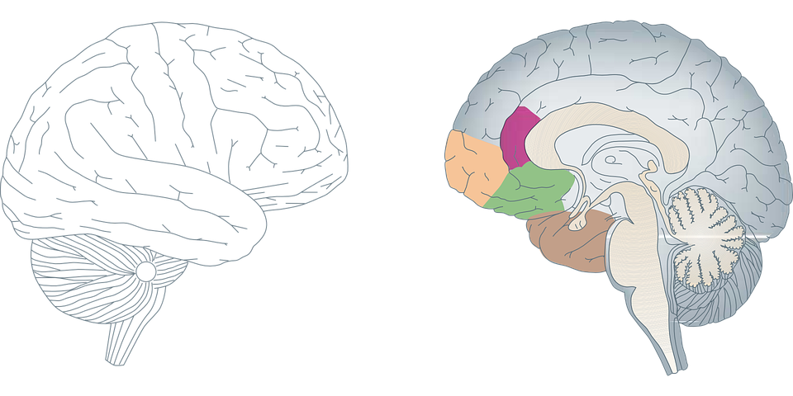

Brain Tumor Detection through MRI Images
Universidade de Aveiro - DETI
Applications of Artificial Intelligence - 41019
Pétia Georgieva
2022/2023
Work done by:
Tiago Alvim - 95584
Vasco Costa - 97746

Slide 2

Brain Tumor
What is it?

Slide 3
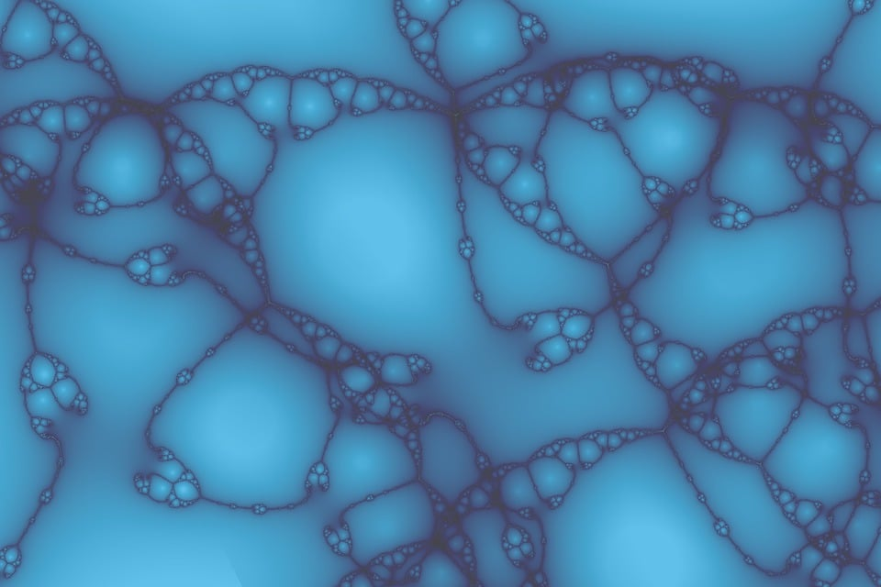
Brain Tumor
Abnormal mass of tissue
Cells grow and divide more than normal
Bening vs Malignant
Timing
MRI - Magnetic Resonance Imaging
Magnetic properties of the body
Radio Waves

Slide 4
CNN
Convolutional Neural Network

Slide 5
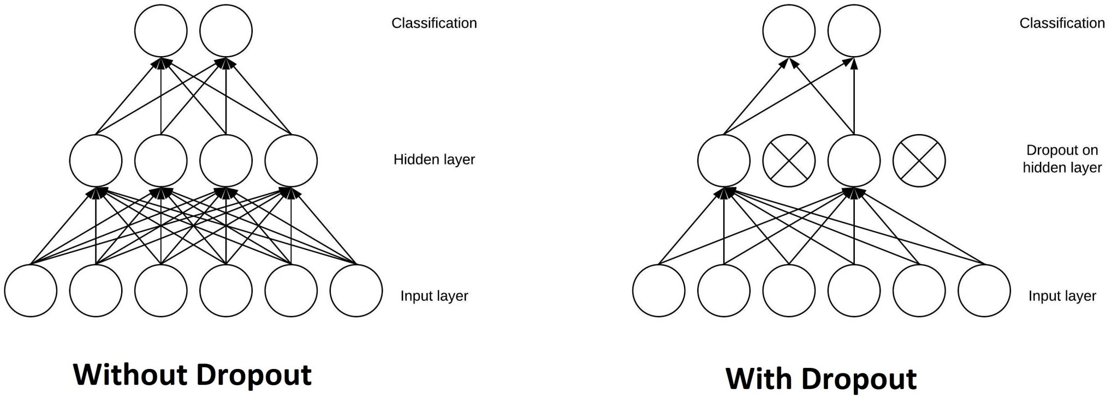
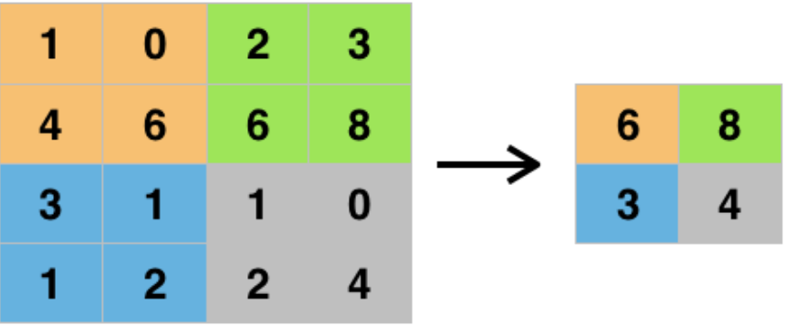
Convolutional Neural Network
Convolutional layer
Dropout layer
Max pooling layer
Dense layer
Figure 1 from https://giphy.com/explore/convolutional-neural-network
Figure 2 from https://www.baeldung.com/cs/ml-relu-dropout-layers
Figure 3 from https://deepai.org/machine-learning-glossary-and-terms/max-pooling

Slide 6
Dataset
Analysis
Preprocessing

Slide 7
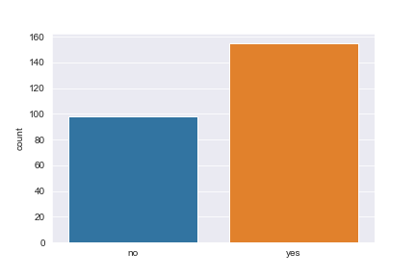
Dataset - Analysis
Author - Navoneel Chakrabarty
Yes/No – 155/98 – 253
No - 150x198 to 1920x1080
Yes – 178x249 to 1275x1427
Before 2018
From Google Images
Figure 4

Slide 8
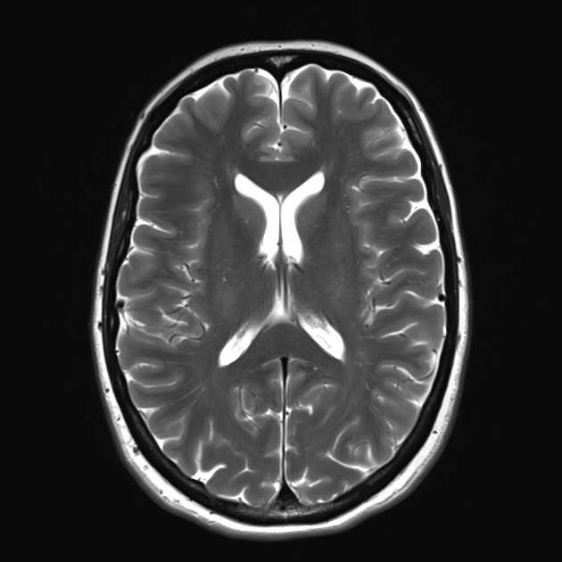
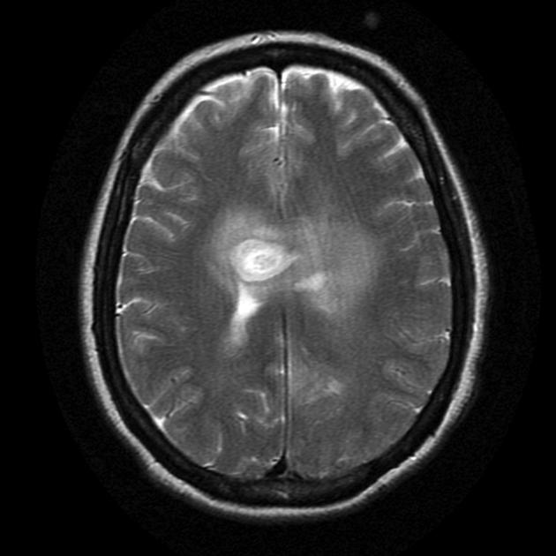

Dataset - Preprocessing
Different sizes
Resizing
Dividing by 255 – RGB/Grey scale
70/30 split
Data augmentation
Flips
Rotation
Shift
Zoom
No
Yes
Figure 5 from the Dataset

Slide 9
Custom Method

Slide 10
Custom Method
Table 1
 |  | Prediction
 |  | No | Yes
Actual value | No | 22(TN) | 5(FP)
 | Yes | 11(FN) | 38(TP)
Better understanding of the process
Based on the class exercice
Simple CNN model
High number of False Negatives
Conv2D
Dropout
MaxPool2D
Flatten
Dense
 | Train | Val
Loss | 0.0380 | 0.7394
Accuracy | 0.9887 | 0.7895
F1 | 0.9889 | 0.8271
Precision | 0.9889 | 0.9123
Recall | 0.9889 | 0.7659
Table 2

Slide 11

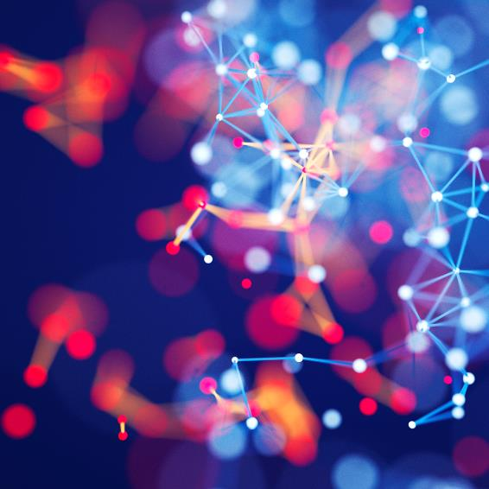
Custom Method - Finetuning
A second compile was added
Smaller step – RMS, 0.0000034
Same confusion matrix
Only the loss changed
Not worth the extra epochs
 | Train | Val
Loss | 0.0282 | 0.7267
Accuracy | 0.9887 | 0.7895
F1 | 0.9889 | 0.8271
Precision | 0.9889 | 0.9123
Recall | 0.9889 | 0.7659
 |  | Prediction
 |  | No | Yes
Actual value | No | 22(TN) | 5(FP)
 | Yes | 11(FN) | 38(TP)
Table 3
Table 4

Slide 12
Transfer Learning

Slide 13
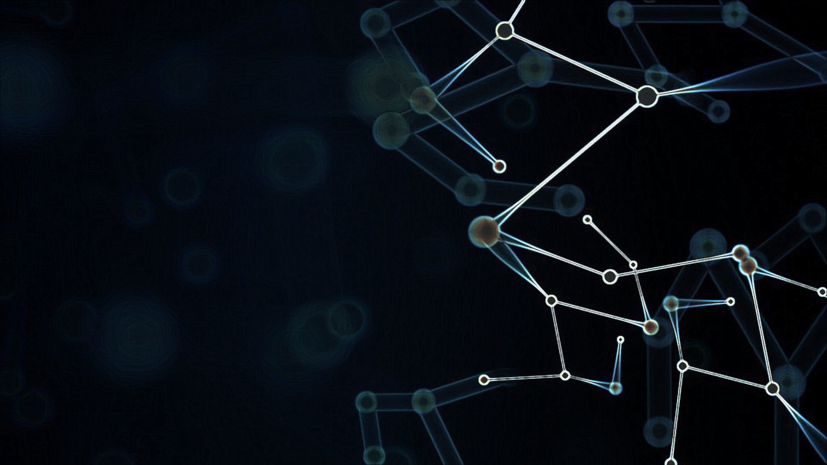
VGG19

Slide 14
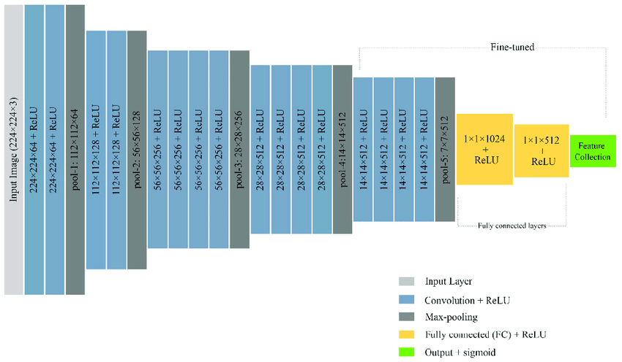
VGG19
Visual Geometry Group at Oxford
19 layers
224x224 pixels – RGB
20,049,473 – parameters
25,089 – trainable
Figure 6 from Mostafiz, R., Rahman, M., Islam, A. & Belkasim, S. machine learning &
knowledge extraction Focal Liver Lesion Detection in Ultrasound Image
Using Deep Feature Fusions and Super Resolution. Machine Learning
And Knowledge Extraction. 2 (2020,7)

Slide 15
VGG19 - Results
Monitoring 5 epochs – Accuracy or F1
F1
Hyperparameter search
Loss and Optimizer
CV – 3
No better results
Data preprocessing
VGG19 | Monitoring
 | Accuracy |  | F1
 | Train | Val | Train | Val
Loss | 0.079956 | 0.322789 | 0.067914 | 0.324886
Accuracy | 0.994350 | 0.828947 | 1.000000 | 0.855263
F1 | 0.994253 | 0.867877 | 1.000000 | 0.882039
Precision | 1.000000 | 0.893519 | 1.000000 | 0.923611
Recall | 0.988889 | 0.845900 | 1.000000 | 0.845900
VGG19 |  | Prediction
 |  | Accuracy |  | F1
 |  | No | Yes | No | Yes
Actual value | No | 21(TN) | 6(FP) | 25(TN) | 2(FP)
 | Yes | 7(FN) | 42(TP) | 3(FN) | 46(TP)
Table 5
Table 6

Slide 16
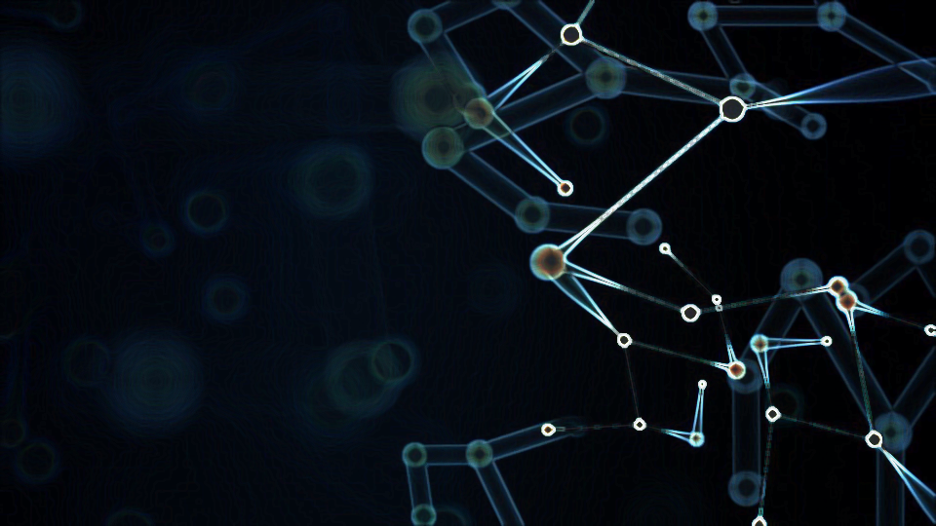
Inception V3

Slide 17
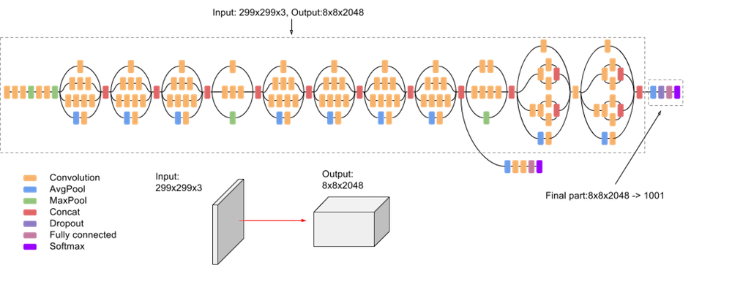
Inception V3
GoogLeNet
42 – layers
299x299 pixels – RGB
21,933,857 – parameters
131,073 – trainable
Figure 7 from https://paperswithcode.com/method/inception-v3

Slide 18
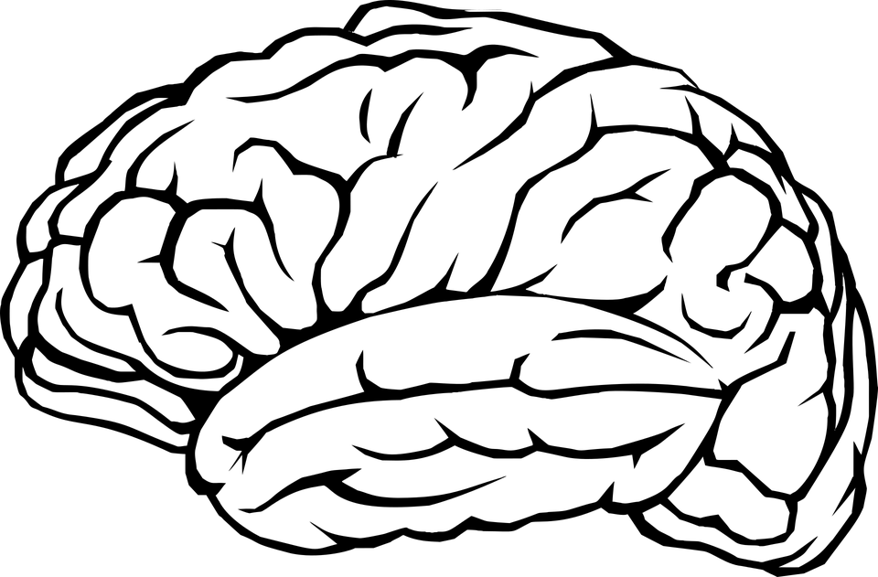
Inception V3 - Results
Table 7
InceptionV3 |  | Prediction
 |  | Accuracy |  | F1
 |  | No | Yes | No | Yes
Actual value | No | 25(TN) | 2(FP) | 26(TN) | 1(FP)
 | Yes | 3(FN) | 46(TP) | 4(FN) | 45(TP)
Monitoring 5 epochs – Accuracy or F1 score
Accuracy
Hyperparameter search
As before
Same conclusions
Smaller Train set
50/50
Better results than Custom Method
InceptionV3 | Monitoring
 | Accuracy |  | F1
 | Train | Val | Train | Val
Loss | 0.000243 | 0.604363 | 0.001483 | 0.787448
Accuracy | 1.000000 | 0.934211 | 1.000000 | 0.934211
F1 | 1.000000 | 0.953982 | 1.000000 | 0.953692
Precision | 1.000000 | 0.965833 | 1.000000 | 0.979167
Recall | 1.000000 | 0.944444 | 1.000000 | 0.930556
Table 8

Slide 19
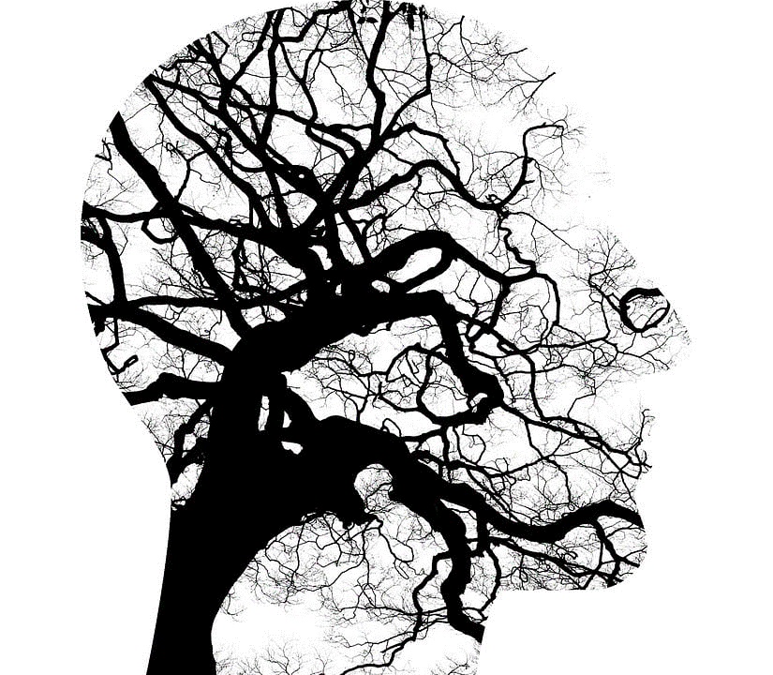
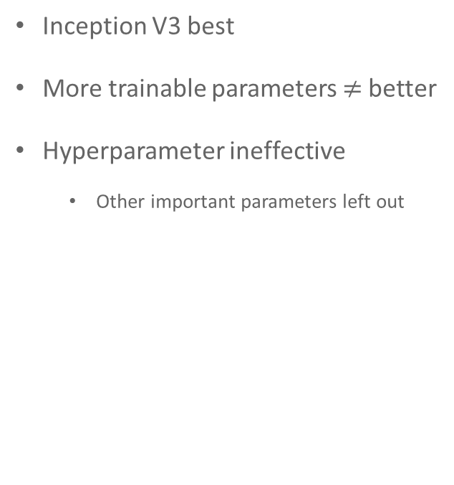
Conclusion
Literature
Model Comparison
Future Work
“100%” accuracy
Only accuracy
Unbalanced
More relevant aspects – False negatives
Test set – small
Inception V3 best
More trainable parameters $≠$better
Hyperparameter ineffective
Other important parameters left out
Images with contrast
Smallest of abnormal spots
Warning for the future
3D – scans
Edge detection for local action

Slide 20
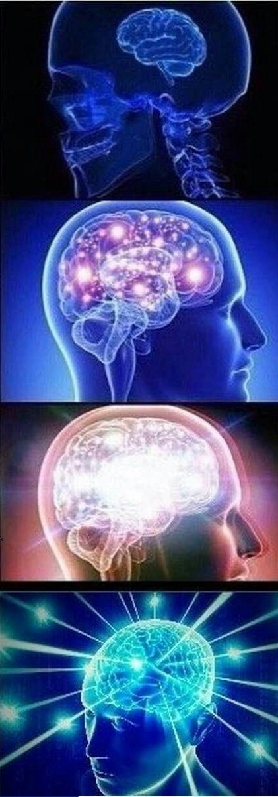
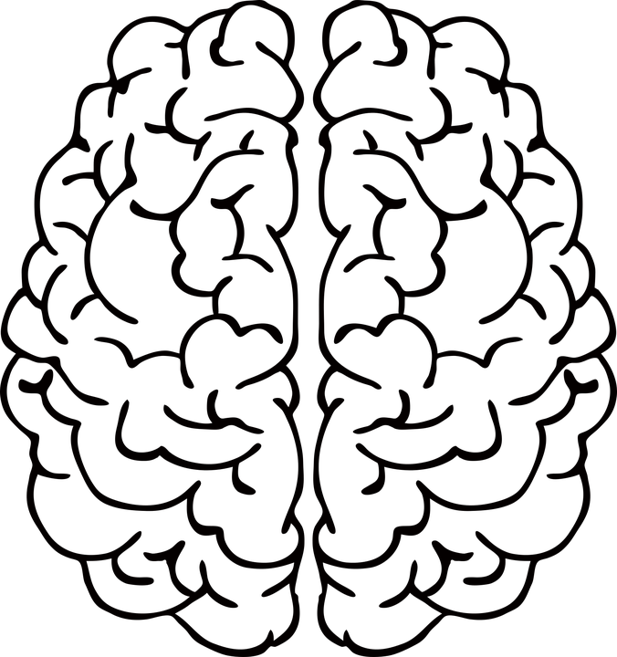
Thank You!
Tumor Detection through MRI Images
Tiago Alvim - 95584
Vasco Costa - 97746
Universidade de Aveiro - DETI
Applications of Artificial Intelligence - 41019
Pétia Georgieva
2022/2023

